Slide 1
Sample Project Demo By Chiogor Ikeomumu

Slide 2
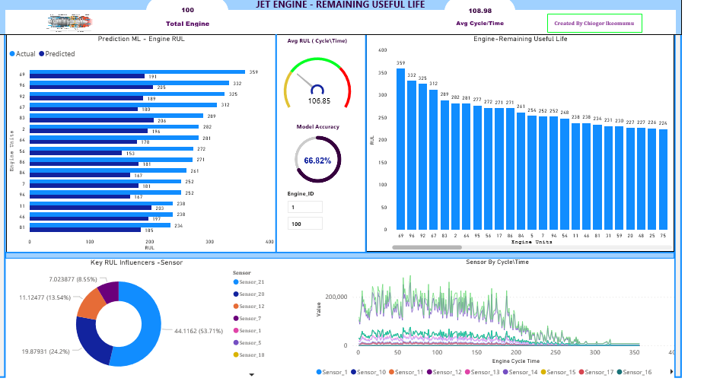
Expected Engine Life Prediction
Click link for interactive report
Expected Engine Life Prediction

Slide 3
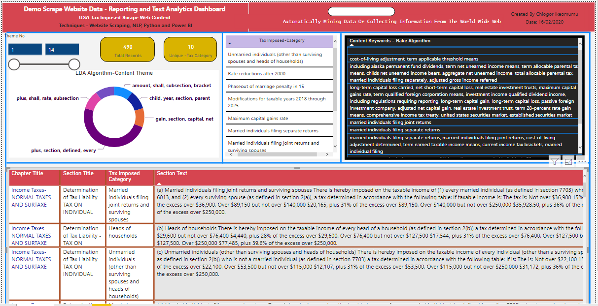
Web Scraping and Text Mining Analytics
Click link for interactive report
Text Mining -Scrape Website Data

Slide 4
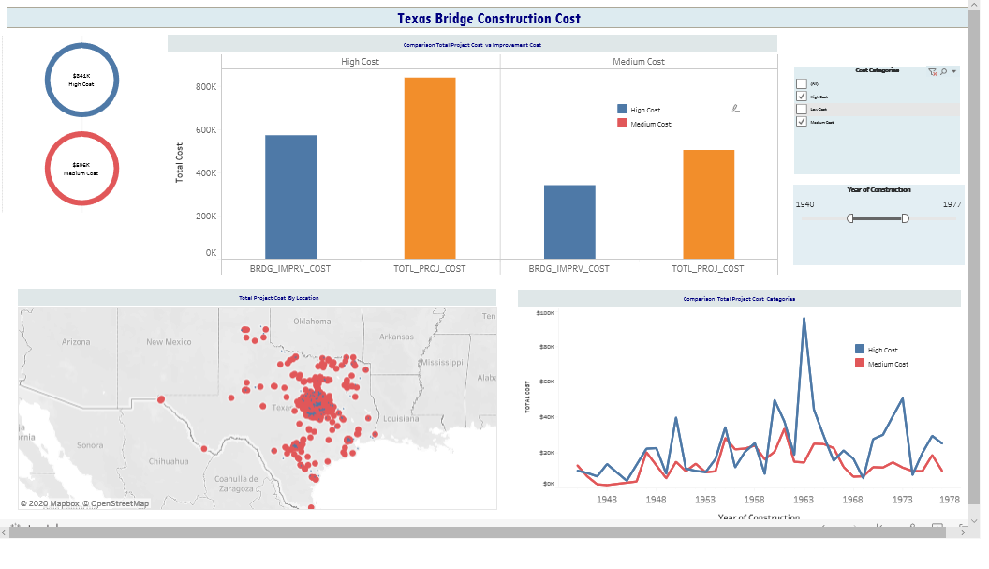
Cost Analysis
Click link for interactive report
Cost Analysis -Tableau

Slide 5
Thank You

